Slide 1
ACATIS QILIN Marco Polo Asien Fonds -
Investing in Asia’s emerging champions
February 2021

Slide 2
Contents
Macro-economic environment and “Next New Normal”
Investment process
Investment examples
Conclusion
Capital investment company and research team
Basic data and communication

Slide 3
Significant Outperformance of the ACATIS QILIN Marco Polo Asien Fund
Performance of the fund versus MSCI AC Asia GDR (EUR),
Time period 11 June 2019 to 2 February 2021
ACATIS QILIN Marco Polo Asien Fund
+74.5% since inception
MSCI AC Asia GDR (EUR)
+29.7%
Source: ACATIS Research GmbH, calculation according to the BVI method

Slide 4
Macroeconomic Environment and the “Next New Normal”

Slide 5

China has taken rigorous measures to flatten the infection curve
Similar to other countries
Different from other countries
Public health tools
Government decrees
Local enforcement
Technology tools
Free testing and treatment
Immediate isolation of infected (fever clinics)
Designated hospitals built in 1-2 weeks (+1000 beds)
>2 months lockdown in Hubei (~60 million people)
Home quarantine (760 million people)
Extended Chinese New Year holiday
Business shut-down
School closure
Entertainment/dining venue shut-down
Public transport suspension
Ban on public gatherings
Security guards patrol public areas
Local neighborhood committees limit movement and deliver groceries
Regular checkpoints and fever monitoring (e.g., residences, buildings, shops, and public transport)
QR color-coded health ratings (red, yellow = quarantine, green = travel)
Contact tracing using mobile apps (big data)
Drones surveillance and broadcasting
CCTV installed outside of residences to ensure quarantine
Containment
Social Distancing
Compliance
Tracking
Source: NYTimes, Washington Post, BBC, SCMP, CNBC, Strait Times, Nature, Qilin Capital analysis

Slide 6
Asia’s long-term development is second to none
More than 50% of the world's population lives in Asia. Asia’s share of the global GDP (purchasing power parity) has exceeded that of the rest of the world. Over 60% of global growth is generated in this region.
China’s GDP, which has grown steadily by over 6% p.a. during the last 25 years, has catapulted the country from the tenth-largest to the second-largest economy in the world.
China will overtake the US as the world's largest economy before 2030 - an outcome that even the escalating US-China trade conflict will not be able to prevent.
Other than China, India and Japan will also be among the world's four largest economies.

Slide 7
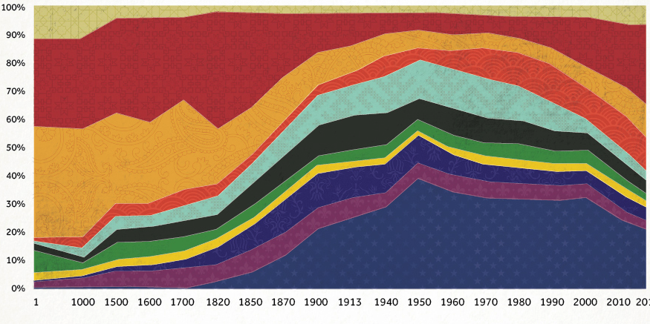
China has historically been a world power in the last 2000 years and will be once again
Percent share of GDP of major economies
Industrial Revolution
China Market Opening
Ancient*
China
Indien
Japan
Russland
Deutschland
Italien
Spanien
Großbritannien
Frankreich
USA
2017
* Greece, Egypt, Iran, Turkey
Quelle: Visual Capitalist, Qilin Capital Analyse

Slide 8
Asia’s share of global GDP has already exceeded that of North America, Europe and Japan
* Share of global GDP is based on purchasing power parity (PPP) basis.
Source: IMF, BlackRock Investment Institute

Slide 9
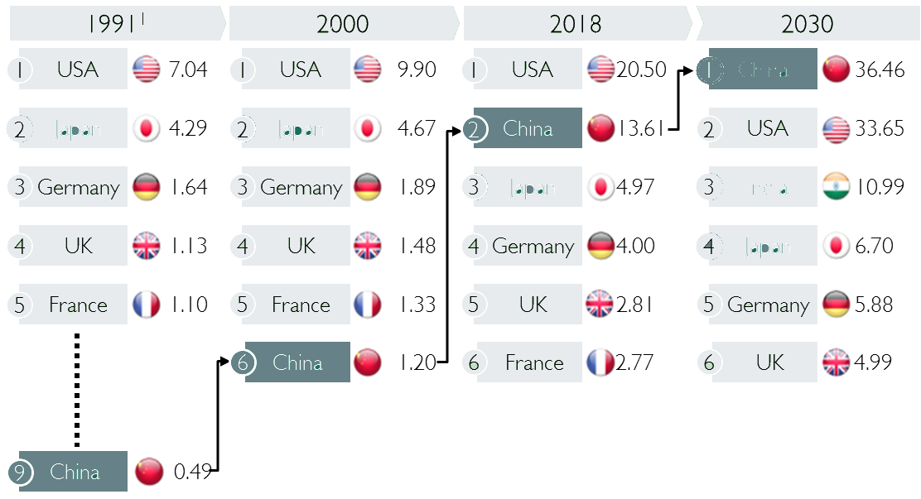




China, India and Japan are on their way to becoming the world's largest economies by 2030
The gross domestic product (GDP) of China, Japan and India compared other global players
(in USD billion, nominal)
1
China
2
Japan
2
2
2
Japan
2
3
3
3
India
Japan
India
4
Japan
4
6
9
1) Data normalized in USD of the year 2000
Source: World Bank, The Economist , McKinsey Analysis

Slide 10







Chinese companies have continually expanded their presence in the Fortune Global 500
Number of Chinese companies in the Fortune Global 500 list
Global Ranking of Chinese Fortune 500 Companies
  In 2019, China has overtaken the US for the first time with 133* companies in the Global Fortune 500 list (12 more Chinese than American companies
  More and more Chinese champions are pushing into the Fortune 500 list (e.g. Gree and Xiaomi)
1
1
2
1
3
1
2
1
* Companies from China, Hong Kong und Taiwan
Source: Fortune, McKinsey Analyse, China Daily, Qilin Capital Analysis

Slide 11

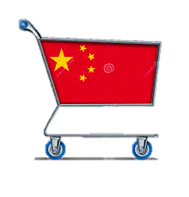
What‘s ahead in China?
1. "Leapfrogging" business systems
2. Expansion of Middle Class
4. “Landgrabbing“
with New Silk Road
3. From Investment- to Consumption-driven GDP growth
900 million Chinese digital payment users versus 30 million in the US
374 million Middle Class Households up from 44 million 10 years ago
Average annual salary increased by 10X in last 20 years fueling consumption
“One Road – One Belt” opening up 63% of global population
Leap-
frogging
Mid-Range Products
Copy
Source: The Economist; World Bank; Qilin Capital Analysis

Slide 12
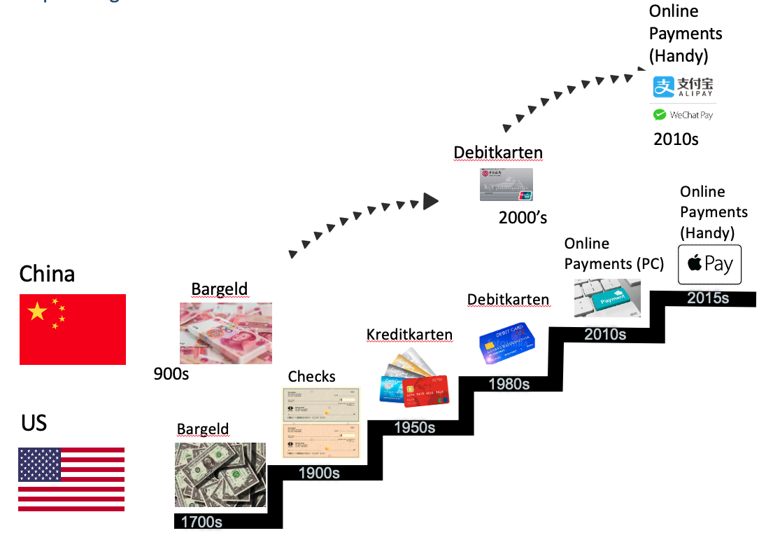
China leapfrogs traditional business models to become an industry "shaper"
Example: Digital payment with mobile phones
Leapfrogging
China has moved from cash to digital payments over the past 10 years.
More than 900 million Chinese use digital payment methods such as Alipay and WeChat, while in the US only 30 million users with Apple Pay.
Other "Leapfrogging" examples
E-commerce vs. brick-and-mortar retail
High-speed trains vs. regional trains
Mobile phones vs. landlines
Electric vehicles vs. internal combustion engines
Quelle: Brookings Institute; China Internet Network Information Center (CNNIC); Emarketer; Qilin Capital Analyse

Slide 13
China's middle class is growing rapidly
Annual disposable household income in RMB
Urban population in China
in millions
2010
2018
Rich
Affluent
Upper middle-class
Middle class
44 Mill./
7%
374 Mill./
46%
Lower middle class
Aspiring
middle class
Lower class
Poor
Source: McKinsey Global Institute, Qilin Capital analysis

Slide 14
China's economy is embarking on a V shaped transformation
Increasing
GDP
Goal:
Shrink to Grow
“Building the Future”
“Restructuring of the Supply Side”
Traditional industries like steel, coal and textiles
Massive restructuring and trimming of overcapacities
Retrain 5-6 million state workers mostly from manufacturing and state-owned enterprises in the next 2-3 years
    Modern fast-growing industries like high-tech, healthcare, education, tourism, and internet
    Higher service components, increased Chinese technology inside, driven by consumption
    Support for innovation by boosting R&D
    Increased investment and reform of education system
  Unprecedented transition from old to next generation economy with 1.4 billion people
Source: Qilin Capital

Slide 15
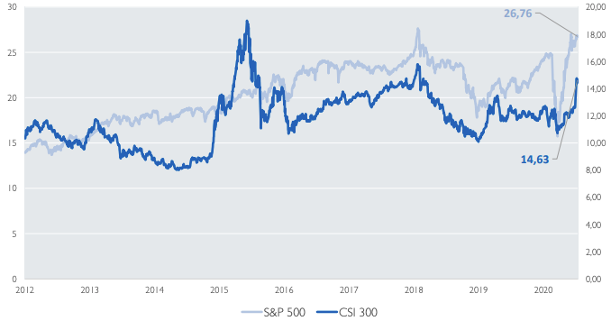
Chinese equities are significantly cheaper that of the US
Comparison of P/E Ratio of S&P 500 and CSI 300 in last 8 years
Source: Wind, Qilin Capital Analysis

Slide 16
CSI 300 index is decoupled from China’s economic development
GDP
CSI
China GDP
(￥bln)
CSI 300
Source: Wind, Qilin Capital Analysis

Slide 17
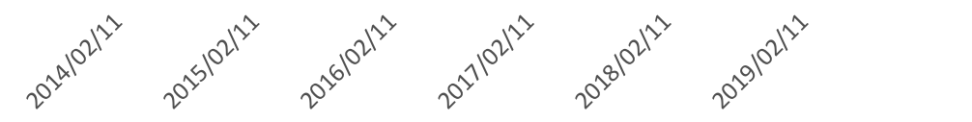
Private companies show a significant outperformance against the SOE*-dominated index
Performance of Private Companies, SOEs und CSI 300 Index
Period 11.02.2014 to 17.01.2020
Top 20 private companies
+641%
Top 20 SOEs
Performance Index
+111%
CSI 300 index
+82%
* State-Owned Enterprises (SOE)
Source: Wind, Qilin Capital Analysis

Slide 18
Market capitalization of Chinese stock exchanges is growing rapidly while those of North American and European companies are shrinking significantly
Market capitalization forecasts
100%
100%
China
Rest of Asia
North America
Europe
Rest of World
Global GDP Ranking
# 1 US
# 2 China
# 3 Japan
# 1 China
# 2 US
# 3 India
Source: Factset, IWF, Weltbank, WFE, Goldman Sachs, Wikipedia, Qilin Analysis

Slide 19
Why invest in Chinese equities?
Short-term rationale
Long-term rationale
COVID-19 in China under control
Businesses back-to-work; 2020 GDP growth estimated at roughly 1-2%
US headed towards possible Corona disaster (health system, jobs, election focus)
European countries fighting individually; will have to wait for a vaccine
Chinese market in V-shape recovery
Long-term uptrend remains; absolute and percent GDP growth highest in the world amongst large economies
Yuan (RMB) on-track to become one of the world’s reserve currencies
2nd largest equity market in the world, but significantly under-represented in global portfolios
Significant growth of foreign investors (currently 3%) in China stock markets
Substantial increase of institutional investors
Inclusion of China in global and emerging market stock indices
World will evolve into two tech hemispheres (US and China)
Invest in China equities
Quelle: Qilin Capital Analyse

Slide 20
Investment Process

Slide 21

DETEC’ fundamental company analysis uses a rigorous, analytical and data-driven approach
Chinese research team on-the-ground
in Shanghai
Is the company a future Asian champion?
Will this company create stock market value for investors?
Industry prioritisation
Historic company performance
Expected company performance
Assessment of soft factors
On-site evaluation
Sector and sub-sector analysis
Macro-trends, including 13th Five-Year Plan
Historic company valuation
Expected future performance indicators
Trend analysis of market share and productivity
Owner analysis
Management assessment
Auditor's assessment
Company visits and management interviews
Product and technology competitiveness
No. of companies
5000
200
100
80
50
Notes:
20

Slide 22
Investment Examples

Slide 23
Features of the ACATIS QILIN Marco Polo Asien Fonds
Focus on present and future Asian growth and value champions with a heavy emphasis on Chinese companies
Focus on attractive, fast-growing future industries; the portfolio does not include industries in need of restructuring
Investments possible in all Chinese share classes, including A shares, H shares and N shares - the only way to invest in the most promising Chinese companies
Focus on listed private companies, since they perform better over the long term, i.e. ideally no state-owned enterprises and hence no ETFs
Objective: Outperform the relevant MSCI All Countries Asia Index
On-site Asian analysis team (which conducts company visits in Chinese)
Extensive and relevant Chinese experience, contacts and network including McKinsey and Tsinghua University

Slide 24


ACATIS QILIN Marco Polo Asien Portfolio (selected sample companies)
 | Ping An Good Doctor is the largest online health platform in the world with 315 million registered users. During the COVID-19 crisis in China from January 20th to February 10th, 1.11 billion users visited the online platform.
 | JD.com is China’s largest online and offline retailer. It is also China’s largest Internet company by sales, and is the third largest company in the world after Amazon and Alphabet
 | New Oriental Education is the leading provider of private foreign language training in the world's fastest-growing education market.
 | Hengrui Medicine is the leading Chinese brand pharmaceutical company with its own patented medications. It is also the leading first-to-market generic drug player with a proven track record in international markets.

Slide 25
Market capitalisation and country allocation
Market capitalisation in %
Country allocation in %
(>100 bn €)
(10-100 bn €)
(1-10 bn €)
As of: 31 December 2020
As of: 31 January 2021

Slide 26
Conclusion

Slide 27
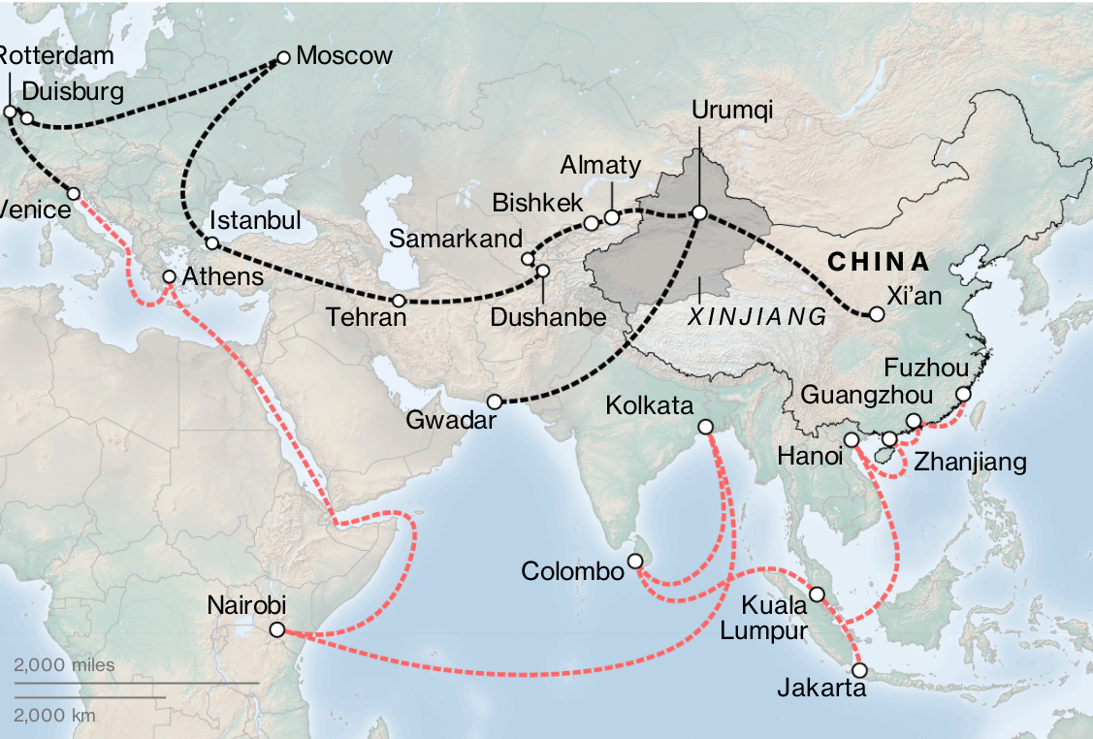
With the ACATIS QILIN Marco Polo Asien Fonds, you gain exposure to the old and new global power that is China and Asia
One Road, One Belt – China’s new Silk Road
New Silk Road - on the road
New Silk Road - on the water
Source: Belt and Road Portal, China‘s National Development and Reform Commission

Slide 28










With the ACATIS QILIN Marco Polo Asien Fonds, you gain exposure to the country that will dominate ten key industries by 2025
China’s master plan 2025
Infrastructure
Technologies
Power equipment
Agricultural machinery
Railway equipment
Aerospace equipment
High-tech ships and ocean engineering
Information technology
Green energy and green vehicles
Robotics
Medicine and medical devices
New Materials
Source: Qilin Capital analysis

Slide 29
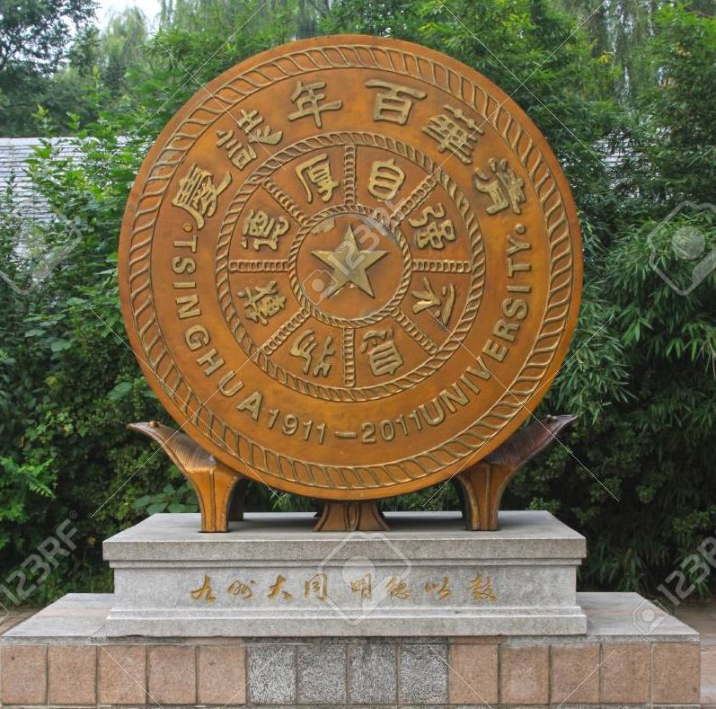
With the ACATIS QILIN Marco Polo Asien Fonds, you gain exposure to a fund with local research expertise and long-standing relationships with China’s industry and policy-makers
Emblem of Tsinghua University, 100-year anniversary
Our research partners at QILIN Capital - Prof. Dr. Ingo Beyer von Morgenstern and Dr. Stefan Albrecht - are honorary professors at China’s elite Tsinghua University.
80% of Chinese Politburo members are Tsinghua alumni.

Slide 30
Significant Outperformance of the ACATIS QILIN Marco Polo Asien Fund
Performance of the fund versus MSCI AC Asia GDR (EUR),
Time period 11 June 2019 to 2 February 2021
ACATIS QILIN Marco Polo Asien Fund
+74.5% since inception
MSCI AC Asia GDR (EUR)
+29.7%
Source: ACATIS Research GmbH, calculation according to the BVI method

Slide 31
Capital Investment Company and Research Team

Slide 32
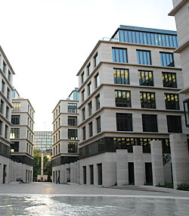
ACATIS Investment
ACATIS – value-focused asset manager founded in 1994.
ACATIS searches for undervalued stocks in a systematic and
databased process.
The monthly investment process is effective and consistent, with the funds achieving outperformance over the long-term.
ACATIS offers value-equity funds, value-balanced funds, value-sustainability funds and value-bond funds. Since October 2016, ACATIS has been offering equity funds based on artificial intelligence.
Assets under management EUR 10.1 bn (as of 31 January 2021).
Notes:
31

Slide 33
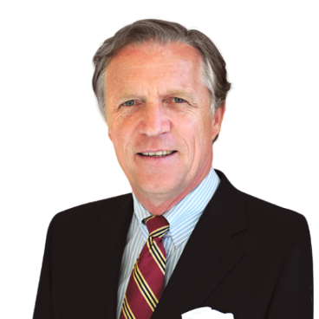
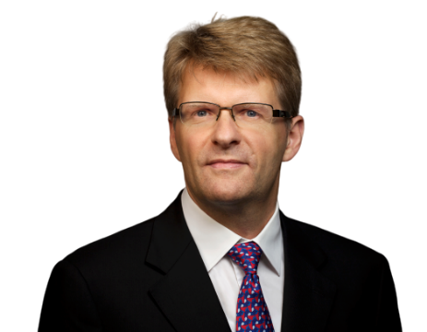
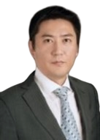

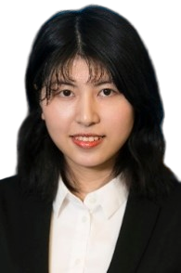
The Qilin Capital core team combines excellent Asia and China research expertise
Prof. Dr. Ingo Beyer von Morgenstern – “Asia and China Insider”
30 years McKinsey & Company, 10 years McKinsey China, McKinsey Asian Practice Leader
Honorary professor at Tsinghua University
Dr. Stefan Albrecht –
“Asia and China Insider”
20 years McKinsey & Company, 15 years McKinsey China, McKinsey Asia Consumer Electronics Practice Leader
Scholar of the “Studienstiftung des deutschen Volkes”
Patrick Liu –
China Research Manager
Manager of Asia Champions Research in Shanghai
Former Manager of McKinsey High-Tech Practice Research in Shanghai
MaryAnn Li –
China Investment Industry Professional
Former Associate Principal at McKinsey & Company in Beijing
Former Manager of McKinsey Venture Capital Practice in Asia
Sofie Wang –
China Research Analyst
Research Analyst at Asia Champions Research in Shanghai
Fund manager of the Hofstra Student Managed Investment Fund in New York

Slide 34



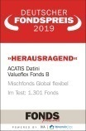

How others evaluate us – ACATIS awards*
 | € Fund Award 2021
 | Fund Manager of the Year 2017 |  | MLP Fund Award 2019
 | Deutscher Fondspreis 2019 (German Fund Award) |  | Lipper Leader
 | Morningstar
*Only awards of the last four years

Slide 35
Basic Data and Communication

Slide 36
Fund data
Investment company | ACATIS Investment Kapitalverwaltungsgesellschaft mbH, Frankfurt
Custodian | UBS Europe SE, Frankfurt
Manager | ACATIS Investment Kapitalverwaltungsgesellschaft mbH, Frankfurt
Share class | A | B | X
Investment focus | Equity Asia with focus on China | Equity Asia with focus on China | Equity Asia with focus on China
Domicile | Germany | Germany | Germany
Currency | EUR | EUR | EUR
Benchmark | MSCI AC Asia GDR (EUR) | MSCI AC Asia GDR (EUR) | MSCI AC Asia GDR (EUR)
ISIN | DE000A2PB655 | DE000A2PB663 | DE000A2P9Q22
Inception | 11 June 2019 | 11 June 2019 | 29 September 2020
Fiscal year-end | 30 September | 30 September | 30 September
Front end fee | 5% | 0% | 0%
Ongoing costs (30 September 2020) | 1.93% | 1.43% | 1.50%
Performance fee | 15% of the yield above the reference value that is generated by the fund during the settlement period (MSCI® AC Asia GDR (EUR), but only if the unit price at the end of the relevant settlement period exceeds the unit price at the beginning of the settlement period.
Minimum investments | Non | 250,000 EUR initial investment | Non
Permission for public distribution | DE, AT, CH, NL | DE, AT, CH, NL | DE, CH, NL
Distribution | Distribution | Distribution | Distribution

Slide 37
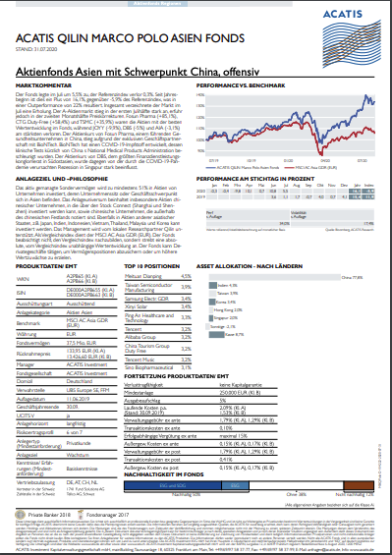

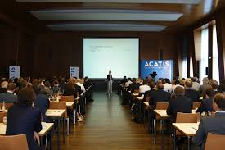
ACATIS und QILIN places great value on investor communication
Monthly report
Webinars und conference calls
Road show, investment dialogues and presentations on the fund

Slide 38
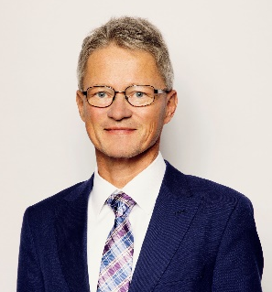
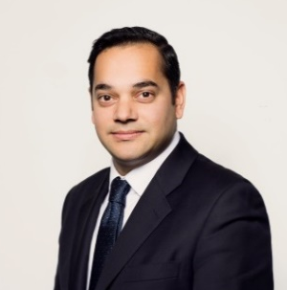
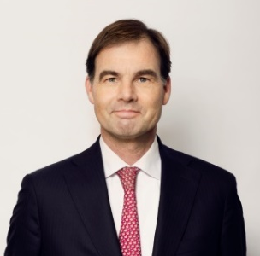

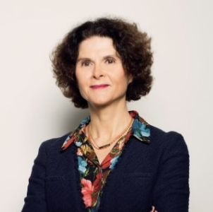
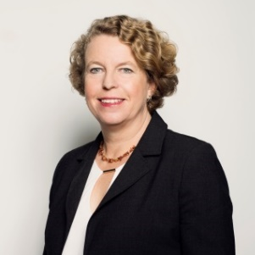
Contact – your persons to contact
Felix Müller
ACATIS Investment
KVG mbH
Tel: +49-69-97 58 37-60
Email: mueller@acatis.de
Member of the Extended Management Board, Sales
Amit Kapoor
ACATIS Investment
KVG mbH
Tel: +44 7500 373 205
Email: kapoor@acatis.com
Institutional Sales
International
Frits Nieuwenhuijsen
ACATIS Investment
KVG mbH
Tel: +31 6 30 00 56 41
Email: nieuwenhuijsen
@acatis.com
Institutional Sales
Netherlands, Belgium, Denmark
Eva Zaragoza
ACATIS Investment
KVG mbH
Tel: +34 648 914 288
Email: zaragoza@acatis.com
Institutional Sales Iberia,
Italy, UK
Marie Ballorain
ACATIS Investment
KVG mbH
Tel: +33 6 79 98 16 73
Email: ballorain@acatis.com
Institutional Sales France,
Benelux
Petra Weise
ACATIS Service GmbH
Tel: +41-71-886 45-51
Email: weise@acatis.ch
Institutional Sales Switzerland

Slide 39

Contact information
ACATIS
Investment Kapitalverwaltungsgesellschaft mbH
Germany
Address
  mainBuilding
  Taunusanlage 18
  D-60325 Frankfurt
  Tel: +49-69-97 58 37-77
  Fax: +49-69-97 58 37-99
  Website: www.acatis.com
ACATIS
Service GmbH
Switzerland
Address
  Güetli 166
  CH-9428 Walzenhausen
  Tel: +41-71-886 45-51

Slide 40
Disclaimer
This document is only intended for information purposes. It is solely directed at professional clients or suitable counterparties in terms of the Securities Trading Act, and is not intended for distribution to retail customers.
Past performance does not guarantee future results. ACATIS accepts no liability that the market forecasts will be achieved. The information is based on carefully selected sources which ACATIS deems to be reliable, but ACATIS makes no guarantee as to its correctness, completeness or accuracy. Holdings and allocations may change. The opinions are those of the fund managers at the time of publication and may not agree with an opinion at a later time. The opinions promote understanding of the investment process and are not intended as a recommendation to invest.
The investment opportunity discussed in this document may be unsuitable for certain investors depending on their specific investment objectives and depending on their financial situation. Furthermore, this document does not constitute an offer to persons to whom it may not be distributed under the respectively prevailing laws.
The information does not represent an offer nor an invitation to subscription for shares and is intended solely for informational purposes. Private individuals and non-institutional investors should not buy the funds directly. Please contact your financial adviser for additional information on ACATIS products. The information may not be reproduced or distributed to other persons.
Not all ACATIS funds are authorized in all European jurisdictions.
ACATIS Investment KVG mbH is headquartered in Germany and provides the sales prospectus, semi-annual report, annual report and "KID" in German free of charge. The documents can be downloaded from the website www.acatis.com.
ACATIS Investment Kapitalverwaltungsgesellschaft mbH is regulated by the German Federal Financial Supervisory Authority, BAFIN, Lurgiallee 12, 60439 Frankfurt.

